Slide 1
GOVERNMENT
What is government?
2. What does a government do?
3. Why do people need government?
4. What types of government
are there?

Slide 2
GOVERNMENT
Types of Governments

Slide 3
GOVERNMENT
What is government?

Slide 4
GOVERNMENT
What is government?
Government is an organization people set up to protect the community and make rules

Slide 5
GOVERNMENT
2. What does a government do?

Slide 6
GOVERNMENT
2. What does a government do?
Protects the community
Makes laws
Keeps order

Slide 7
GOVERNMENT
3. Why do people need government?

Slide 8
GOVERNMENT
3. Why do people need government?
For protection of people and
property
Making rules
Enforcing laws

Slide 9
GOVERNMENT
4. What types of government
are there?

Slide 10
GOVERNMENT
4. What types of government
are there?
Four common types are:
Monarchy
Dictatorship
Democracy
Theocracy

Slide 11

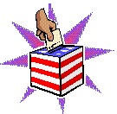
Democracy
In a democracy, the government is elected by the people. Everyone who is eligible to vote has a chance to have their say over who runs the country. It is distinct from governments controlled by a particular social class or group
A democracy is determined either directly or through elected representatives.

Slide 12
Direct Democracy
People vote directly on every issue
Only practical in a small community

Slide 13
Representative Democracy
People are represented by elected officials
Used in large countries
Also known as a Republic government

Slide 14
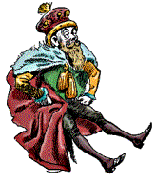
Monarchy
Power is in the hands of a king, queen, emperor or empress.
The ruling position can be passed on to the ruler’s heirs.
In some traditional monarchies, the monarch has absolute power.
But a constitutional monarchy, like the UK, also has a democratic government that limits the monarch's control.

Slide 15
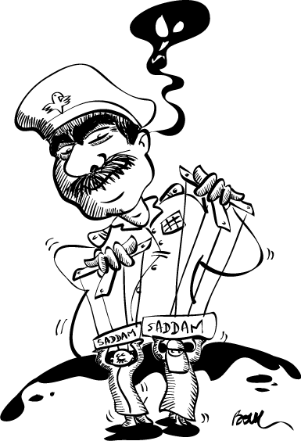
Dictatorship
A country ruled by a single leader. The leader has not been elected and may use force to keep control.
In a military dictatorship, the army is in control.

Slide 16
Theocracy
Governmental rulers are identical with the leaders of the dominant religion
Governmental policies are either identical with or strongly influenced by the principals of the majority religion.
Government claims to rule on behalf of God or a higher power

Slide 17
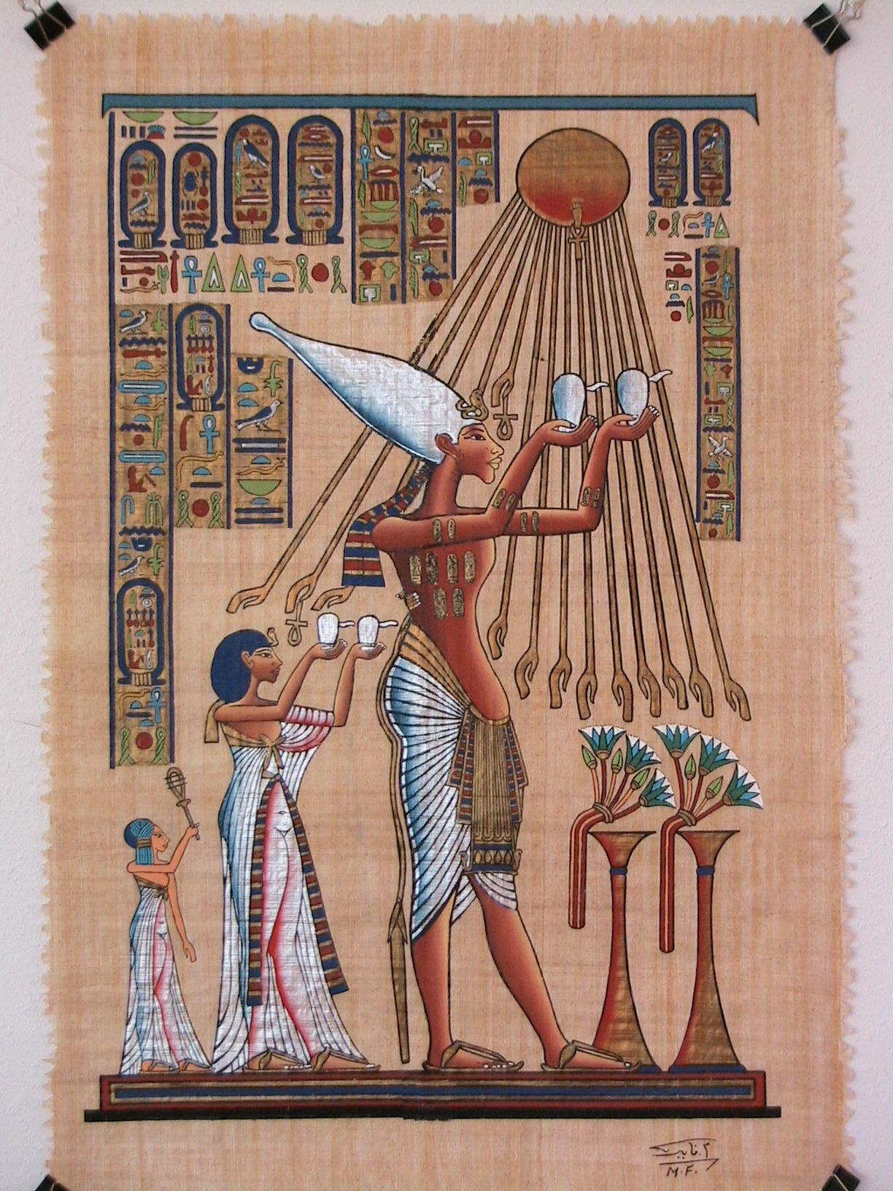
1. NAME THAT GOVERNMENT:
The pharaoh was an absolute ruler. He commanded the army and controlled irrigation and grain supplies. People in this society considered the pharaoh to be a god.

Slide 18
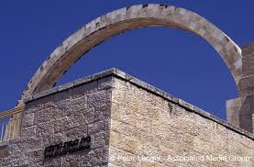
2. NAME THAT GOVERNMENT
In the first century AD, the Greeks recognized three types of government: monarchy, aristocracy, and anarchy. The Jews at the time did not fit into any of these categories as they believed only God and his laws were sovereign.

Slide 19
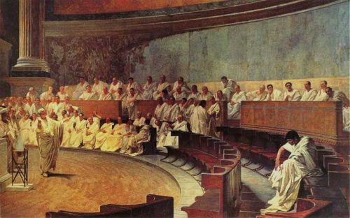
3. NAME THAT GOVERNMENT:
In 450 B.C. this civilization assembled and all citizens voted on laws. A council of 500 prepared business for the assembly.

Slide 20
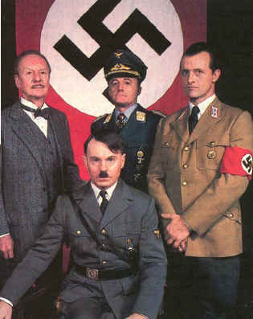
4. NAME THAT GOVERNMENT:
The Nazi Party took over every aspect of this country’s social, economic & political life. Hitler quickly secured his power by burning down a legislative building and used the incident to obtain emergency powers, becoming an absolute ruler.

Slide 21
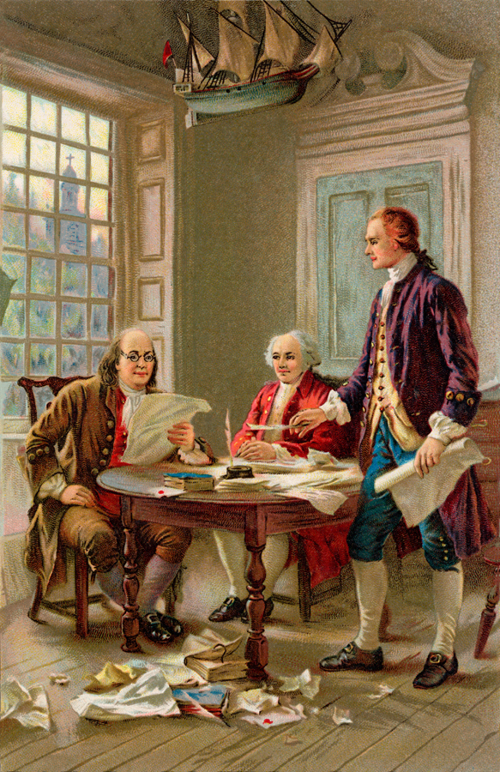
5. NAME THAT GOVERNMENT:
In this country some people are elected to make laws and some people are appointed officials.

Slide 22
1. NAME THAT GOVERNMENT:
The pharaoh was an absolute ruler. He commanded the army and controlled irrigation and grain supplies. People in this society considered the pharaoh to be a god.
Monarchy

Slide 23
2. NAME THAT GOVERNMENT
In the first century AD, the Greeks recognized three types of government: monarchy, aristocracy, and anarchy. The Jews at the time did not fit into any of these categories as they believed only God and his laws were sovereign.
Theocracy

Slide 24
3. NAME THAT GOVERNMENT:
In 450 B.C. this civilization assembled and all citizens voted on laws. A council of 500 prepared business for the assembly.
Direct
Democracy

Slide 25
4. NAME THAT GOVERNMENT:
The Nazi Party took over every aspect of this country’s social, economic & political life. Hitler quickly secured his power by burning down a legislative building and used the incident to obtain emergency powers, becoming an absolute ruler.
Dictatorship

Slide 26
5. NAME THAT GOVERNMENT:
In this country some people are elected to make laws and some people are appointed officials.
Representative
Democracy

